Slide 1
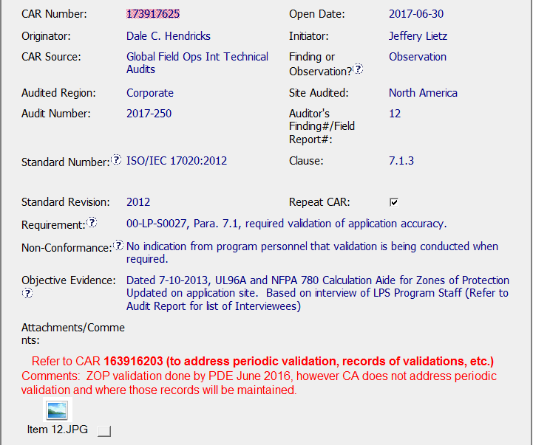
Observation CAR # 173917625

Slide 2
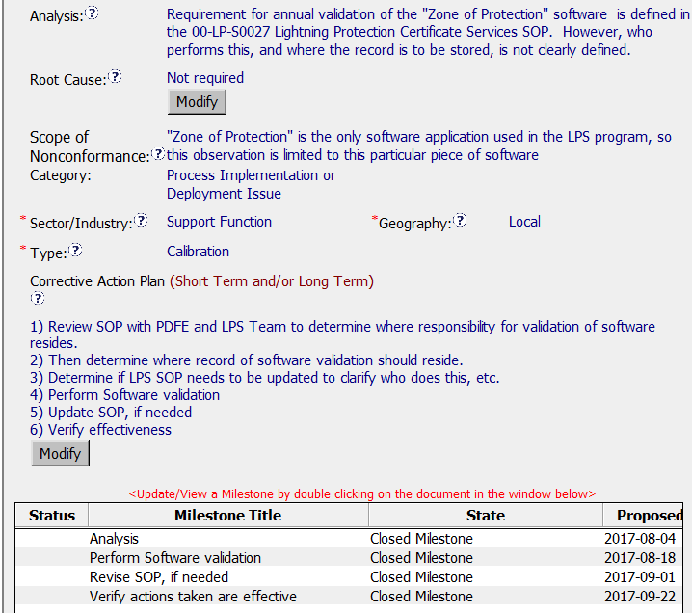
Observation CAR # 173917625

Slide 3
Observation CAR # 173917625
Explain how/If the analysis supports the root cause statement
(CR) There is NO Root Cause Statement for this CAR. It states “Not required”.
FAQ 37 states - Observation CARs require that all sections of the CAR are completed including analysis, root cause statement, scope of nonconformance, corrective action plan and milestones. Based on the Analysis documented in this CAR a Root Cause may not be able to be clearly defined.

Slide 4
Observation CAR # 173917625 cont.
Explain why/If the evidence in the milestones was sufficient to confirm that the nonconformity was eliminated
(CR) My determination is inconclusive, but the evidence in these milestones seem to be sufficient to confirm that the nonconformity was eliminated. However, there was NO Root Cause listed and the evidence in the milestones seem to address the issues determined by the Analysis.
However, either this CAR should have been determined to be a FINDING or the Corrective Actions in this CAR are a symptom of waste –overproduction based on the following:
The Analysis Milestone was not needed, the actions I this Milestone should have been listed as a part of the Analysis and noted in the Analysis portion of the CAR.
The Implementation Evidence for the Analysis Milestone did not include any records or evidence of actions
Both the Revised SOP, if needed and the Perform Software validation Milestones could have been listed as the Correction Milestone to address the issue of non- verified Zone of Protection software for the specified UL96A and NFPA 780 testing.
Too many non-relevant Milestones were listed per requirement for Observation CAR’s.

